Slide 1
Analyzing Sentiments: A Comprehensive Examination

Slide 2
Introduction
Welcome to the presentation on Analyzing Sentiments. This comprehensive examination will delve into the intricacies of sentiment analysis and its applications in various domains. We will explore the methodologies and tools used to analyze sentiments in textual data.

Slide 3
Understanding Sentiment Analysis
Sentiment analysis, also known as opinion mining, is the process of determining the emotional tone behind a series of words. It involves the use of natural language processing and text analysis techniques to identify and extract subjective information from text data.

Slide 4
Methods of Sentiment Analysis
There are various methods for sentiment analysis, including lexicon-based approaches, machine learning algorithms, and deep learning models. Each method has its own strengths and limitations, and the choice of method depends on the specific requirements of the analysis.

Slide 5

Applications of Sentiment Analysis
Sentiment analysis has diverse applications across industries, including brand monitoring, customer feedback analysis, social media monitoring, and market research. It enables organizations to gain valuable insights from unstructured textual data.

Slide 6
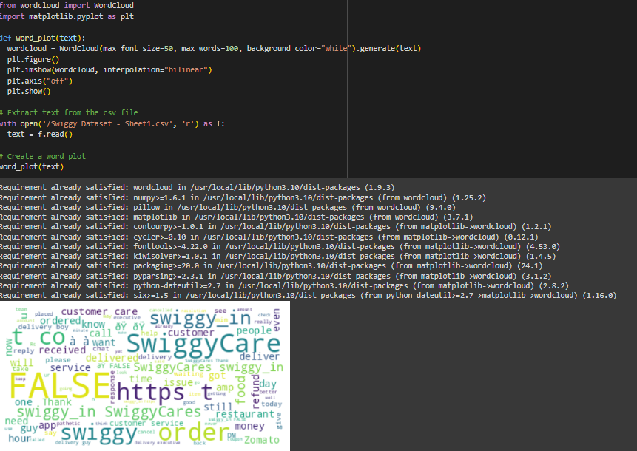
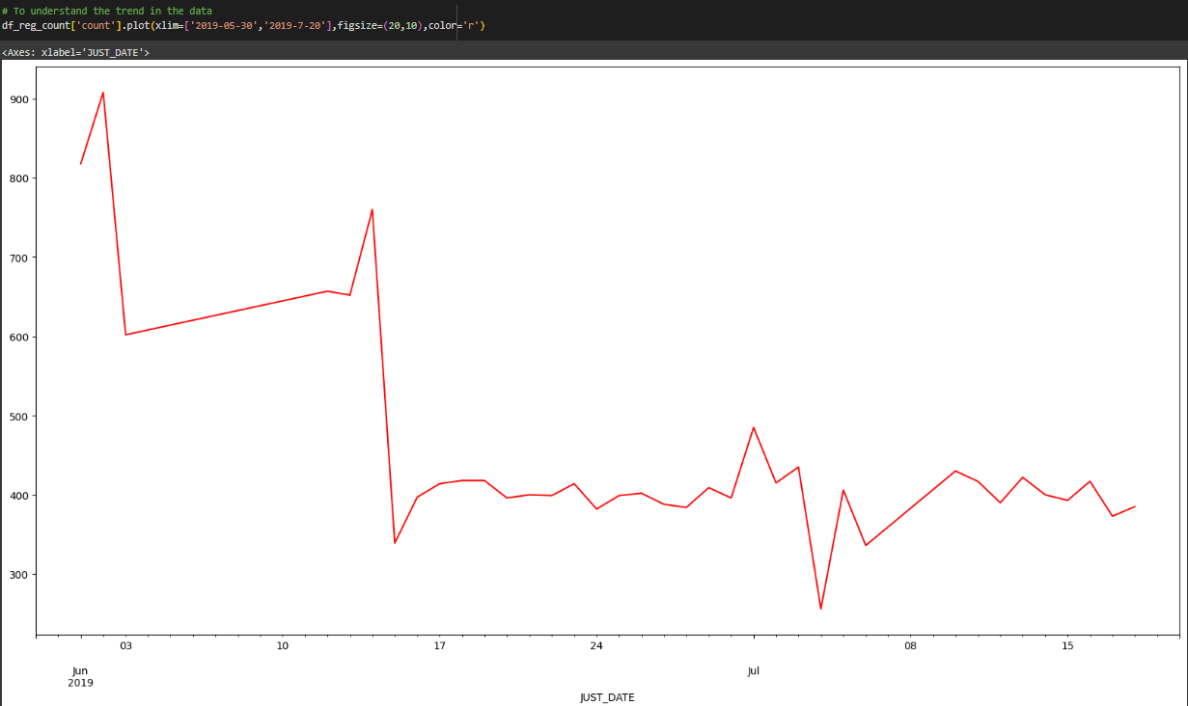
DATA INSIGHTS

Slide 7
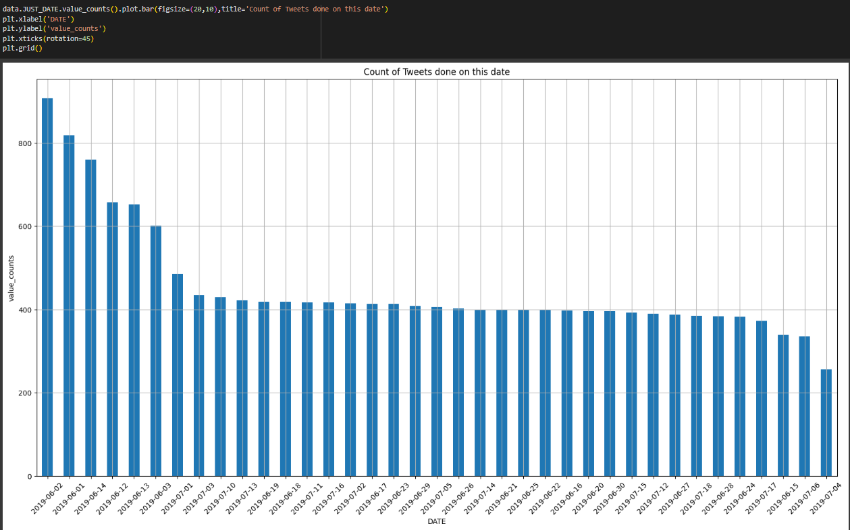
DATA INSIGHTS

Slide 8
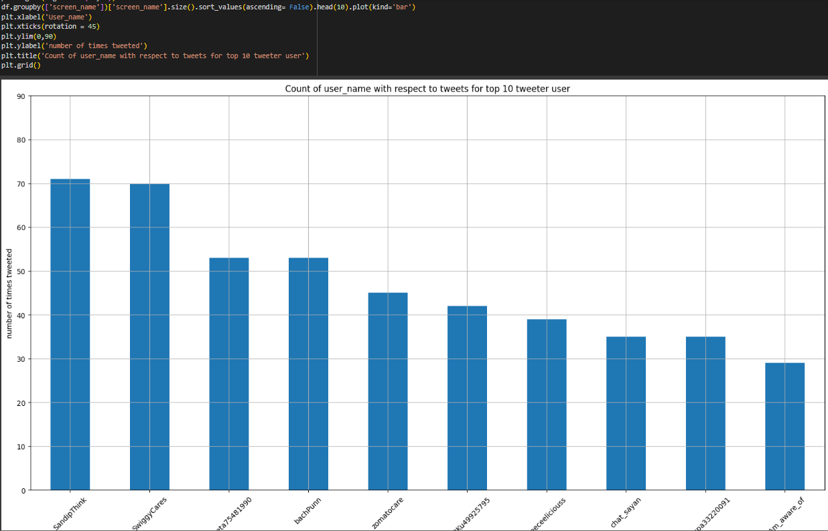
DATA INSIGHTS

Slide 9
Challenges in Sentiment Analysis
Despite its usefulness, sentiment analysis faces challenges such as sarcasm detection, contextual understanding, and multilingual sentiment analysis. Overcoming these challenges is crucial for improving the accuracy and reliability of sentiment analysis.

Slide 10
Conclusion
In conclusion, sentiment analysis plays a pivotal role in understanding public opinion and making data-driven decisions. As technology continues to advance, the future of sentiment analysis holds promising developments in emotion recognition and real-time analysis.

Slide 11
Thank You

